Slide 1
Sentiment Analysis of Customer service tweets
JAWs Team - CS410
Joan Ball, Alex Ginglen, Walter Griebenow

Slide 2
Objective
Monitor effectiveness of the service center in improving customers satisfaction and compare to industry benchmarks
Find the topics most asked for in the tweets and their typical sentiment
Portray the characteristics of a successful interaction with the customer

Slide 3
Process followed
Customer Sentiment: initial & final
Compare by industry / time
2
1
Text cleaning
Convert emoticons to words
Associated tweets into Threads
Topic analysis
Relate to sentiment
3
Sentiment change after interaction
Language of effective interactions
4

Slide 4


1. Pre processing
Cleaning
Remove unneeded Twitter Handles
Remove urls and &amp;
Emoji to text
Replace emoticons with corresponding english words (grin face, happy face)
Weave tweets into Threads
Gather related tweets in a sequence to build a conversation

Slide 5

1. Translate Emojis
Script
EmojiTranslate.py
Process
Remove Emojis for topic analysis
Translate emojis to text description for sentiment analysis
Smile Face

Slide 6
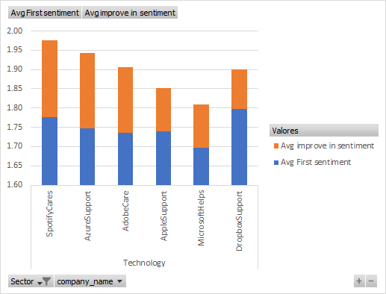
2. Effectiveness of customer service
Initial sentiment of customer tweets is improved by interaction with the customer service team.
How do we compare? (Tech industry)
Spotify not only has better initial sentiment but also they are better in improving the final sentiment.
Microsoft lags behind.

Slide 7
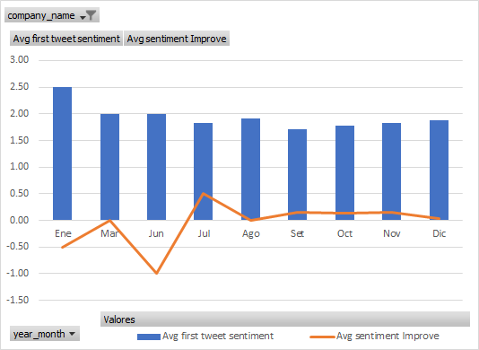
2. Monitoring the sentiment in time
Timely detect changes in sentiment of customer tweets.
Delta Airlines does better than the average of its industry, but there is always space for improvement.
Did something different happen in June 2017?

Slide 8

3. Topic Analysis Process
Remove Stopwords
Incorporate Bigrams Component
Incorporate TF-IDF Component
Create model using Latent Dirichlet Allocation
Execute model on list of tweets
Aggregate list of Tweets with assigned topics

Slide 9
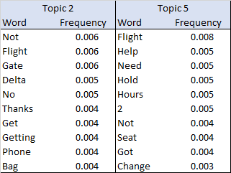
3.Topic Analysis Results
Generated topics did not directly match single, clear topics identifiable by humans.
Topics tended to match some specific areas
Topic 2 tended to match tweets about gates.
Topic 5 tended to match tweets requesting help or being on hold.
In order to identify coherent and granular topics consistently, our algorithm would need human intervention such as in text categorization or by providing a pre-classified list of tweets

Slide 10
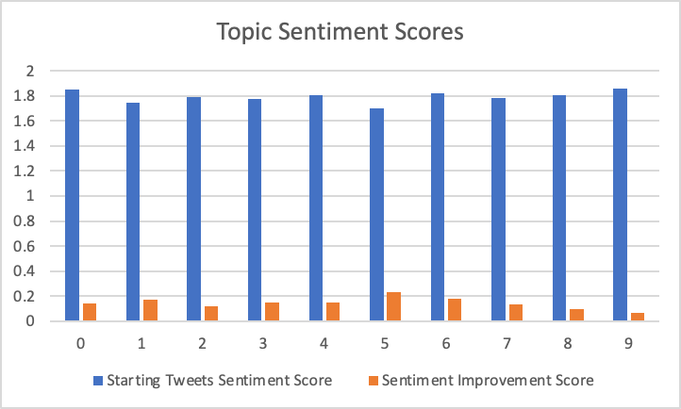
3.Topic to Sentiment
Some topics tended to have higher average sentiments than others
Topic 0 tended to match tweets praising customer service and had a higher average sentiment starting a tweet thread
Topic 5 tended to match tweets requesting help and being on hold and had the lowest average sentiment starting a tweet thread
The more positively associated topics tended to improve less in sentiment
Airlines may need to pay special attention to topics that have a low starting sentiment and a low sentiment improvement

Slide 11
4. Successive Sentiment
More granular than overall sentiment
Instead of evaluating company success, evaluating what successful or helpful speech looks like
Sentiment analysis isn’t perfect, makes for some interesting results!

Slide 12
4. Successive Sentiment: “Best” Results
Customer
Correct strong positive change, but the CS tweet did not assist in any way
somebody from @VerizonSupport please help meeeeee weary face weary face weary face weary face I'm having the worst luck with your customer service
Customer Service
Help has arrived! We are sorry to see that you are having trouble. How can we help?
Customer
@VerizonSupport I finally got someone that helped me, thanks!
Analysis not always perfect, but it’s not hard to see where things were interpreted wrong
Customer
Customer
Might have interpreted “wining” as “winning”.
“good luck” also added to evaluating as positive sentiment
Another awful experience with ; never forget ;retweet and fly ANY other carrier;
Good feedback!
@Uber_Support Thanks - our baby is &lt;12mos and we need our car seat to fly so I was wondering if we can bring our own car seat and install via belt buckle in any UberX to go to the airport
Customer Service
This definitely isn't what we want to hear, Lynn. Can you tell us what happened?
Customer Service
Hi there! Yes, you're always welcome to bring your own car seat along for the ride.
Customer
Customer
@British_Airways Stop wining and fly with Albatros Airlines, good luck.
@Uber_Support Ok great, thanks!

Slide 13
4. Successive Sentiment: “Worst” Results
Customer
Customer response not related to CS response
Someone bring me some McDonald's breakfast I'll love you forever
Customer Service
Attention Earth! We need a hero to step up and get Tyler some breakfast, pronto! :)
Customer
@McDonalds Supporting the NFL is supporting racism
Lots of these were genuinely confusing
Customer
Guys please deep this! I was ranting about the shit service I received from and this fake amazon account posed as them and asked for my card details, address etc then BLOCKED ME face with tears of joy face with tears of joy face with tears of joy face with tears of joy weary face weary face weary face weary face Beware guys !
Customer
Not sure how to interpret this as a human
Good interpretation!
@USCellularCares iPhone 8+ 64GB gold
Customer Service
That device is on backorder. We’re waiting on Apple to send more. Once the phone is available it will ship in the order it was received.
Customer Service
Thanks for bringing this to our attention! I have reported this to the appropriate team.
Customer
Customer
@USCellularCares you all have different things to say, the stores and costumer service said they’re not on back order anymore and now they are person shrugging light skin tone ‍ female sign ️
@AmazonHelp Looool idiots face with tears of joy face with tears of joy

Slide 14
4. Successive Sentiment: Unigrams
Best Tweets, N=51 |  | Good Tweets, N=3460
Word | Frequency | Word | Frequency
hi | .0276 | please | .0241
sorry | .0256 | sorry | .0159
service | .0191 | hi | .0154
please | .0191 | help | .0133
dm | .0191 | dm | .0113
lapse | .0127 | here | .0101
general | .0127 | let | .0088
nature | .0127 | know | .0079
concern | .0127 | like | .0074
clarissa | .0127 | look | .0070
“Best” tweets have sentiment change +3
“Good” tweets have sentiment change greater than or equal to +2

Slide 15
4. Successive Sentiment: Unigrams
Worst Tweets, N=28 |  | Bad Tweets, N=2226
Word | Frequency | Word | Frequency
please | .0306 | please | .0223
steam | .0306 | sorry | .0169
let | .0204 | hi | .0168
know | .0204 | help | .0137
that | .0204 | dm | .0095
key | .0153 | here | .0094
concern | .0153 | let | .0084
could | .0153 | there | .0082
ok | .0153 | know | .0076
sent | .0153 | thank | .0068
“Worst” tweets have sentiment change -3
“Bad” tweets have sentiment change less than or equal to -2

Slide 16
Future improvements
Enhance Topic detection by initializing topics with keywords:
Airlines: flight delay, bag claim, phone long, cancel refund, etc.
Technology: battery life, screen size, game start, etc.
Model the Quality of employee response as a Function of Language used: Q=f(L)
Naïve Bayes logit regression: TF best CS tweets TF worst CS tweets
Add Bigrams as language features, here we analyzed unigrams only
Industry, Topic, Time as context

